Slide 1
Encouraging Consistent Translation Choices
Ferhan Ture, Douglas W. Oard, Philip Resnik
University of Maryland
NAACL-HLT’12
June 5, 2012

Slide 2
Introduction
MT systems typically operate at sentence-level
Useful information available at higher levels
Goal: “One translation per discourse” in MT (Carpuat’09)
  similar to “one sense per discourse” in WSD

Slide 3
Related Work
Limited focus on super-sentential context in MT
Post-process translation output to impose heuristic (Carpuat’09)
Replace each ambiguous translation within document by most frequent one (Xiao et al’11)
Translation memory to find similar source sentences
(Ma et al’11)
Domain adaptation biases TM/LM using in-domain data (Bertoldi&Federico’09, Hildebrand et al’05, Sanchis-Trilles&Casacuberta’10; Tiedemann’10; Zhao et al’04)
Notes:
Xiao et al = Based on their error analysis, the authors indicate two shortcomings when trying to find the correct translation of a given phrase. First, frequency may not provide sufficient information to distinguish between translation candidates, which is why we take rareness into account when scoring translation candidates. Another problem is, like any other heuristic, that there may be cases where the heuristic fails and there are multiple senses per discourse.
(Gimenez&Marquez’07; Liu et al.’10; Brown’08)

Slide 4
Exploratory Analysis
Goal: Does bitext exhibit “one translation per discourse”?
Forced decoding: Find most probable derivation (using SCFG) that produces source-target sentence pair
Experiments on Ar-En MT08 dataset
  assume discourse = document
  74 documents / 813 sentences
Notes:
Hiero-style synchronous context-free grammar (SCFG)

Slide 5

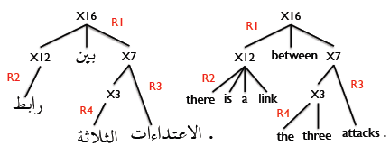
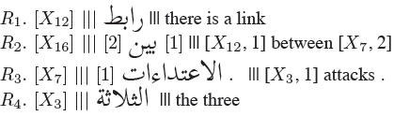
Exploratory Analysis
Method

Slide 6
Exploratory Analysis
Counting cases
[1]
[1]
[1]
[1]
[1]
[1]
[1]
قتلوا
مقتل 9
]2[ مقتل
قتل
مقتل
مقتل بهجوم
بهجوم
بهجوم
]2[ بهجوم
]2[ بهجوم
في
في
في
في
في
…
[X1] ‘s fighters were killed
nine [X1] killed
[X1] that [X2] killed
to kill [X1]
killing of [X1]
launch attacks
in a
in an attack
[X1] [X2] assault
[X1] a [X2] offensive
to
a
into
's
of
…
Case |  | Count
Source phrase | Doc #
مقتول | 566 | killed = 2 killing of = 1
الرهائن | 782 | hostages = 2
الرهائن | 138 | hostage = 1 hostages = 2
من | 30 | from = 2
التي | 30 | the = 1 which = 1
NO
YES
YES
YES
NO

Slide 7
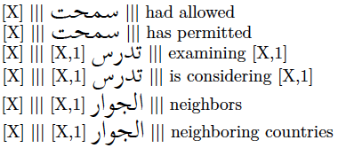
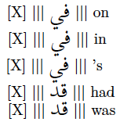
Exploratory Analysis
Results
176 cases, occurring in 512 sentences (63% of test set)
  consistent translation in 128/176 (73%)
  analysis of remaining 48 cases:
29 content-bearing words
19 other words

Slide 8
Exploratory Analysis
Conclusions
Data supports “one translation per discourse”
  potential for improvement
Inconsistent translations may refer to stylistic choices
  fixing such cases will not degrade accuracy
Encourage consistency, do not enforce it
  sentence structure conventions may require the same phrase to be translated differently

Slide 9
Approach
Inspired by Information Retrieval (IR):
count words in document
→ count translations in document pair
Okapi bm25 term weight
… X …
…Y…
X … X …
… X …
Y… Z
… house …
…caterpillar…
House … cat…
… houses …
Dog … dogs
pair TF DF
X, house 3 116/10⁶
X,cat 1 10317/10⁶
Y,caterpillar 1 1066/10⁶
Z,dog 1 15650/10⁶
Y,dog 1 15650/10⁶
… house …
…caterpillar…
House … cat…
… houses …
Dog … dogs
word TF DF
house 3 116/10⁶
cat 1 10317/10⁶
caterpillar 1 1066/10⁶
dog 2 15650/10⁶
Notes:
Three features in mt system’s translation model
Score for each rule …
Two pass decoding
Goal = Biasing model with doc-lvel context

Slide 10
Approach
Goal: Encourage translation model towards consistency, given document-level translation information
Three MT consistency features C₁, C₂, and C₃, each implementing a variant of this idea
A two-pass decoding approach
  first pass: perform translation without any consistency feature
  second pass: compute a feature score for each rule, based on per-document counts from first pass, and add this to model

Slide 11
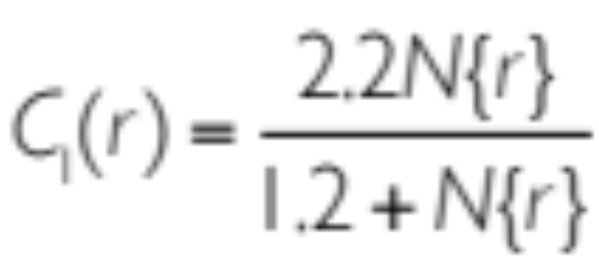
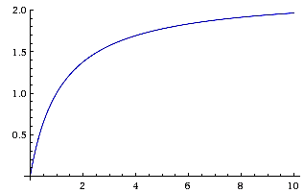
C₁: Counting rules
rule used in first pass
count occurrence of string “LHS ||| RHS” for each used rule
award more frequent rules
count from
first pass
R₁:
R₂:
R₃:
R₄:
R₅:
بريطانيا
بريطانيا
بريطانيا
بريطانيا
بريطانيا
[X,1] ||| britain , [X,1]
[X,1] ||| britain [X,1]
[X,1] ||| uk [X,1]
||| britain
||| the uk

Slide 12
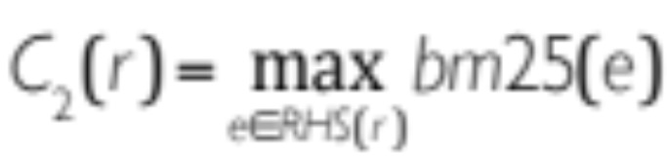
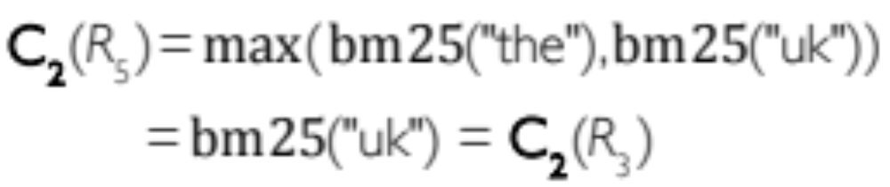
C₂: Counting target tokens
count each target token e of each used rule
award more frequent and rare words
e.g.
R₃:
R₅:
بريطانيا
بريطانيا
[X,1] ||| uk [X,1]
||| the uk

Slide 13
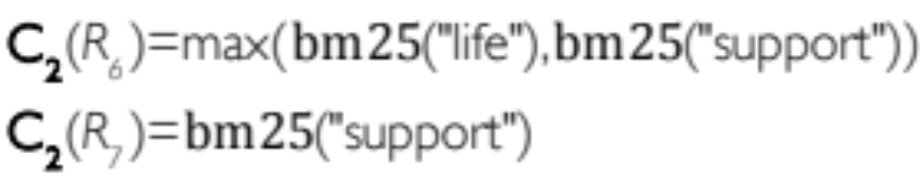
C₂: Counting target tokens
count each target token e of each used rule
award more frequent and rare words
R₆: [X,1] الاخيرة علي [X,2] ||| [X,1] on a life support [X,2]
R₇: يؤيد ||| support

Slide 14
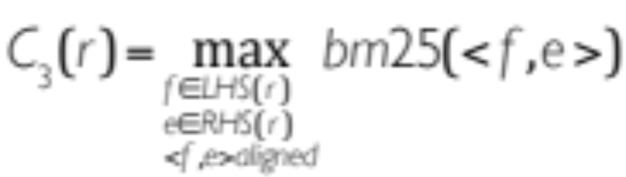
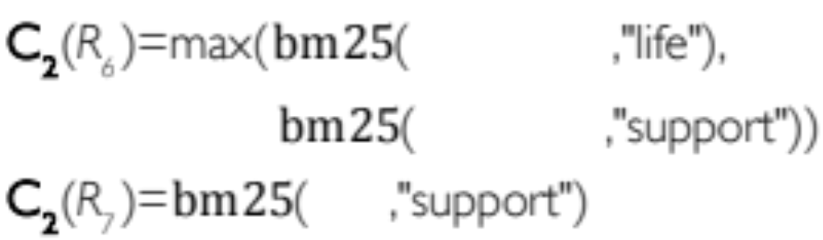
C₃: Counting token pairs
count occurrence of each <source, target> token pair aligned to each other in a used rule
award more frequent pairs and rare target sides
R₆: [X,1] الاخيرة علي [X,2] ||| [X,1] on a life support [X,2]
R₇: يؤيد ||| support
الاخيرة علي
الاخيرة علي
يؤيد

Slide 15
Evaluation
Setup
Experiments using cdec with Hiero-style SCFG
GIZA++ for word alignments, MIRA for tuning feature weights, SRILM for 5-gram English LM
 | Arabic-English | Chinese-English
Preprocess | simple punctuation + ATBv3 segmentation (lattice of two) | Stanford segmenter
Train | 3.4m sentences from GALE, NIST | 1.6m sentences from NIST
Tune | MT06 104 docs, 1797 sentences | MT02 100 docs, 878 sentences
Test | MT08 74 docs, 813 sentences | MT06 79 docs, 1664 sentences
Baseline BLEU (4 references) | 53.07 1st in MT08 | 30.43 4th in MT06

Slide 16
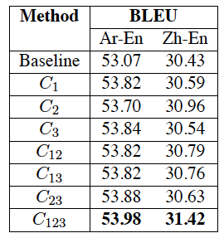
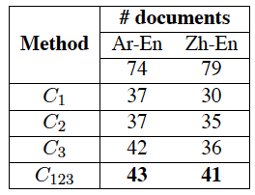
Evaluation
BLEU score improvement

Slide 17
Evaluation
Case-by-case changes
Method | Arabic-English |  | Chinese-English
 | # cases | % of test set | # cases | % of test set
C₁ | 77 | 24 | 401 | 48
C₂ | 127 | 35 | 686 | 60
C₃ | 101 | 33 | 491 | 53
C₁ or C₂ or C₃ | 197 | 68 | 968 | 94
C₁₂₃ | 141 | 41 | 651 | 59
Any = C1 or C2 or C3
Sample 60 of 197 = 26 BLEU⬆ 14 BLEU⬇
C₂ most aggressive (16+ 9-)
C₁ most conservative in # changes (8+ 5-)
C₃ good balance (16+ 4-)

Slide 18


Evaluation
Examples
Source phrase | Context | Output
organizational/regulatory | organizational groups supporting terrorism | Base: 1 “organizational”, 1 “regulatory” C₁,C₂: 2 “organizational” Refs: “organized” and “organizational” | +
Border/frontier troops/guards | violence along India-Nepal border | Base: 1 “frontier guard”, 1 “border troop” C₁,C₂,C₃: “border” → “frontier” Refs: all use the word “border” | -
sneak/infiltrate/enter w/o permission | Turkey trying to enter European Union | Base: 1 “sneak”, 1 “infiltrate” C₂,C₃: 2 “infiltrate” Refs: each consistent, “worm its way”, “sneak”, “sneak into”, “enter” | - ?
Notes:
Work on How to describe third case

Slide 19
Conclusions
A novel technique to test “one translation per discourse”
Three consistency features in translation model brings solid and consistent improvements in MT
Future ideas:
Try alternatives to bm25, max-token, BLEU…
Choosing the right discourse – document or collection?
Learning other patterns from forced decoding
Notes:
Finally … we are at the beginning of exploring this new perspective in mt research. And still left with lots of questions to answer, but this work has shown that it is worthwhile to look beyond he sentence level in translation context, and I hope that more MT researchers start doing the same.

Slide 20
Thank you!

Slide 21
Exploratory Analysis
Forced decoding example
Arabic:
English:

Slide 22
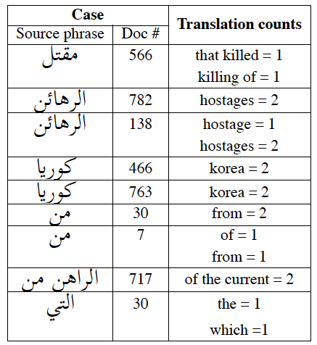
Exploratory Analysis
Method
Keep track of all grammar rules used in forced decoding (i.e., R)
Count unique (f, d) pairs s.t. f appears in multiple rules in R_{d}
Group together rules with minor differences
  الرهائن , ||| hostages
  الرهائن ||| hostage
Remove cases s.t. source phrase has no alternative translation

