Slide 1

“Ask Your TV”
Real-Time Question Answering with Recurrent Neural Networks
Ferhan Ture & Oliver Jojic
SIGIR Industry Track
July 20, 2016
dclabs.comcast.com

Slide 2
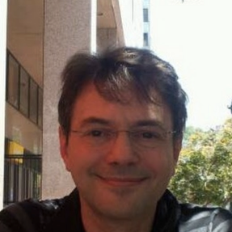

Big Companies
Big Data
No Labeled Data!
Notes:
Research at Comcast Labs
Comcast vs T&P vs Compass vs our lab
Role of our group:
-- provide recommendations (convince) business side about state of the art
-- build prototypes of “the next cool feature”
-- X1 platform
Challenges:
-- big yet small
-- media / cable vs tech
-- scale

Slide 3


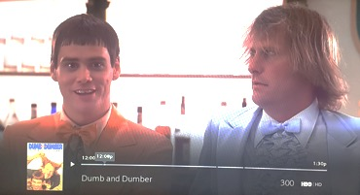


X1 Smart TV with Voice
Voice remote
ASR
NLP modules
Set-top Box
TV
Answer
Selector
query
action
“HBO”

Slide 4
X1 Smart TV with Voice
Voice remote
ASR
NLP modules
Set-top Box
TV
QA
Question
(text)
Answer
(id or text)
query
action
“who plays the oracle in matrix”
Notes:
Remove bottom labels to top

Slide 5
First-order Question Answering
Given:
Question in natural-language form q
Structured knowledge base that contains list of facts
[ subject – relation – (attribute) – object ]
Return:
Answer to q
Assuming:
q answerable by a single fact.
Source entity mentioned in q.
Answer is neighbor of source entity node.
subject
“9/1/1956”
“Tom Hanks”
object
“Matrix”
“Keanu Reeves”
actor
birthdate
relation
attribute
“Neo”
Notes:
While this seems to limit the problem a lot, it actually still covers many of the factual questions that a typical person would ask (e.g., how high is Mt. X?, how old is Y)

Slide 6
Question Answering with Knowledge Graph
Model
Structured
Query
subj=e
obj=?
attr=?
rel=r
Question
Retrieval
Fact
subj | rel | (attr) | obj
e | r | e’
Knowledge
Graph
Notes:
Two main subproblems to solve:
modeling question as a structured query.
Given structured query, retrieve relevant fact(s) in KG.

Slide 7
Example
When was Tom Hanks born?
entity
Notes:
Input is a question, from which we predict a relation type, and extract the entities.
Given knowledge graph, we filter out all parts of the graph that do not meet constraints i.e., reachable by all entities and only of predicted relation type.
This currently works great (and extremely fast) for the type of questions we have trained for. Give some examples from test set.
First, we identify what/who the question is asking about. This corresponds to a node in the KG (shown by orange). Then, based on our assumption, the answer must be one of this node’s neighbors (shown by blue nodes). We just need to figure out which one. For this, if we look at the question, we will notice that

Slide 8
Example
When was Tom Hanks born?
entity
Relation=birthdate
Tom
Hanks
9/1/56
Notes:
Input is a question, from which we predict a relation type, and extract the entities.
Given knowledge graph, we filter out all parts of the graph that do not meet constraints i.e., reachable by all entities and only of predicted relation type.
This currently works great (and extremely fast) for the type of questions we have trained for. Give some examples from test set.

Slide 9
Example
When was Tom Hanks born?
entity
Relation=birthdate
entity=“Tom Hanks”
rel=birthdate
Tom
Hanks
birthdate
9/1/56
Notes:
Input is a question, from which we predict a relation type, and extract the entities.
Given knowledge graph, we filter out all parts of the graph that do not meet constraints i.e., reachable by all entities and only of predicted relation type.
This currently works great (and extremely fast) for the type of questions we have trained for. Give some examples from test set.
Color underline

Slide 10
Example
Who played Donovan in Bridge of Spies?
subject
Bridge
of
Spies
Notes:
Input is a question, from which we predict a relation type, and extract the entities.
Given knowledge graph, we filter out all parts of the graph that do not meet constraints i.e., reachable by all entities and only of predicted relation type.
This currently works great (and extremely fast) for the type of questions we have trained for. Give some examples from test set.

Slide 11
Example
Who played Donovan in Bridge of Spies?
attribute
subject
Relation=actor
subj=“Bridge of Spies”
obj=?
attr=“Donovan”
rel=actor
Tom
Hanks
actor
actor
Bridge
of
Spies
James
Donovan
Notes:
Input is a question, from which we predict a relation type, and extract the entities.
Given knowledge graph, we filter out all parts of the graph that do not meet constraints i.e., reachable by all entities and only of predicted relation type.
This currently works great (and extremely fast) for the type of questions we have trained for. Give some examples from test set.

Slide 12
Example
List me Big Bang Theory episodes
Relation=episode
subject
…
…
synopsis
synopsis
subj=“Big Bang Theory”
obj=?
attr=?
rel=episode
s1e1
s12e20
episode
episode
.
.
.
s1e2
episode
BBT
episode
…
synopsis
episode
.
.
.
s7e9
s1e3
synopsis
synopsis
…
…
Notes:
Input is a question, from which we predict a relation type, and extract the entities.
Given knowledge graph, we filter out all parts of the graph that do not meet constraints i.e., reachable by all entities and only of predicted relation type.
This currently works great (and extremely fast) for the type of questions we have trained for. Give some examples from test set.

Slide 13
Question Answering with Knowledge Graph
Model
Structured
Query
subj=e
obj=?
attr=?
rel=r
Question
?
Retrieval
Fact
subj | rel | (attr) | obj
e | r | e’
Knowledge
Graph
Notes:
So how do we solve these two subproblems. First, modeling…

Slide 14
Question Answering with Knowledge Graph
Structured
Query
subj=e
obj=?
attr=?
rel=r
Predict
Relation
relation
r
Question
Entity
Detection
names / titles
[ e₁, …, e_{N} ]
Notes:
Issues with using KG for training the model:
Overfitting to the knowledge graph (i.e., trained model performs badly on questions for which answers are in a different KG): this is actually fine since we do not need to generalize to other knowledge graphs.
Overfitting of model to training questions (i.e., trained model performs badly on unseen questions about this KG): we need to be careful about this, and I’ll talk about several remedies.

Slide 15
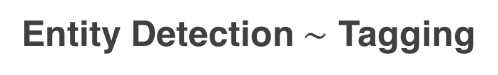

Recurrent Neural Networks (RNNs) for QA
Entity Detection $\sim$ Tagging
Relation Prediction $\sim$ Classification
memory
memory
place
of death
NA
Subj
Subj
NA
NA
where
bin
laden
got
killed
where
bin
laden
got
killed

Slide 16
Research vs. Industry
Scale
Toy data vs. Millions of entities
Speed
Complex model vs. Real-time app
Data
Labeled benchmark dataset vs. ?

Slide 17
No Labeled Data?
relation
r
Structured
Query
subj=e
obj=?
attr=?
rel=r
Predict
Relation
Question
Entity
Detection
names / titles
[ e₁, …, e_{N} ]
subj | rel | (attr) | obj
Train
Knowledge
Graph
?
Notes:
Issues with using KG for training the model:
Overfitting to the knowledge graph (i.e., trained model performs badly on questions for which answers are in a different KG): this is actually fine since we do not need to generalize to other knowledge graphs.
Overfitting of model to training questions (i.e., trained model performs badly on unseen questions about this KG): we need to be careful about this, and I’ll talk about several remedies.

Slide 18
Creating Synthetic Data
Tom Hanks | actor | (James Donovan) | Bridge of Spies
Who plays James Donovan in Bridge of Spies?
Who acted in Bridge of Spies?
Which actors are part of Bridge of Spies?
Which movies does Tom Hanks appear in?
Has Tom Hanks ever acted in a movie?
What roles has Tom Hanks played?
.
.
.
{ Question Templates }
Tom Hanks
actor
Bridge
of
Spies
James
Donovan
Notes:
…
CREATE TEMPLATES FOR EACH RELATION TYPE.
E.G. TEMPLATES AND HOW MUCH EFFORT REQUIRED TO DO IT
GENERATE INSTANCES OF TEMPLATE
TRAIN/VAL/TEST ON THIS DATASET

Slide 19
Preliminary Results
100% accuracy
100% accuracy
100% accuracy
output (label)
.
Val
Test
Model
subj | rel | obj
Train
Knowledge
Graph
Notes:
Idea introduced in 80s, with various implementations over the years.
Became scalable through recent advances in computational power and training techniques.
Natural choice for sequence modeling tasks (i.e., sentences)

Slide 20
Solutions to Overfitting
Synthetically generate more variations of training data
“When was X released” OR “When was X aired” OR “When was X produced” or “When X produced” …
Modify the model to become more lenient
Notes:
Idea introduced in 80s, with various implementations over the years.
Became scalable through recent advances in computational power and training techniques.
Natural choice for sequence modeling tasks (i.e., sentences)
animation

Slide 21
Experimental Results
Entertainment Knowledge Graph: 75.2M facts, 10.5M nodes, 54 relation types.
Synonym
Noise
750K
140K
360K
Vocab (OOV) | Embedding
577K (389K) | word2vec Google News 300-dim
Base synthetic data (D₀)
Expanded synthetic data (D₁)
Expanded synthetic data with noise (D₂)
Notes:
We hold out 5% for validation and 10% for testing.

Slide 22
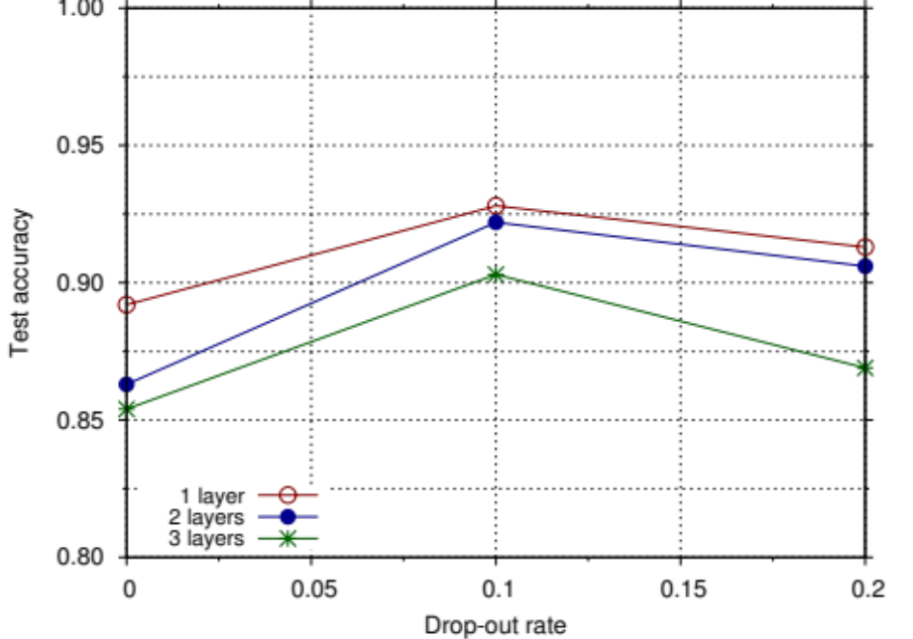
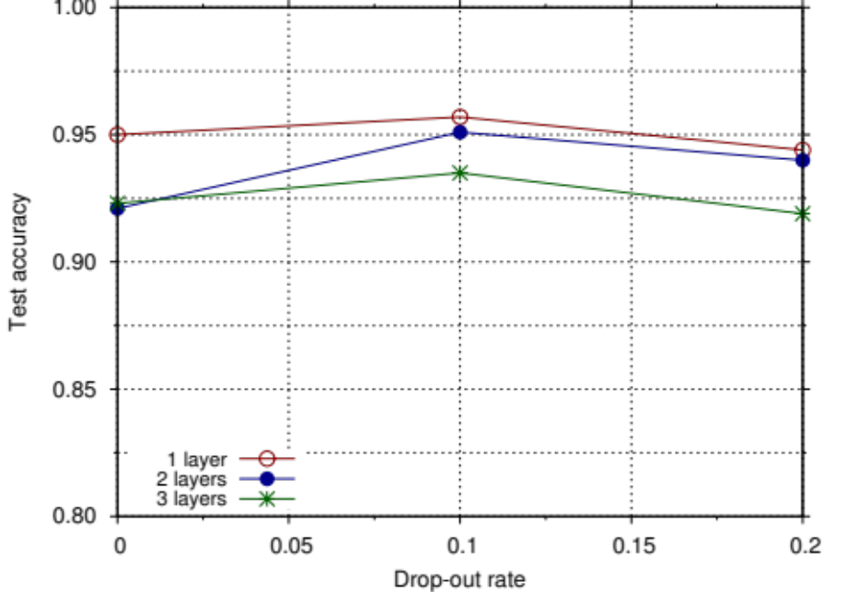
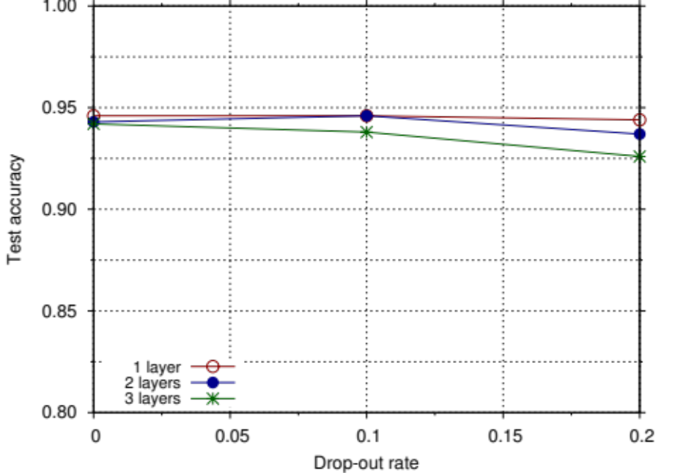
Experimental Results: Relation Prediction
Training Data
Base Synthetic Data
(D₀)
Expanded synthetic data
(D₁)
Expanded synthetic data with noise
(D₂)
Test Accuracy
Drop-out rate
Drop-out rate
Drop-out rate
10% drop-out is optimal.
Improved synthetic data → Improved model.
Deeper models are not better.
Notes:
Parameters
Drop-out in {0, 0.1, 0.25, 0.5}
Synonymous data in {0, 0.3, 0.6, 1.0}
Noisy data in {0, 0.3, 0.6, 1.0}
1 or 2 LSTM layers
For each setting, we report train / validation / test and end-to-end accuracy.

Slide 23
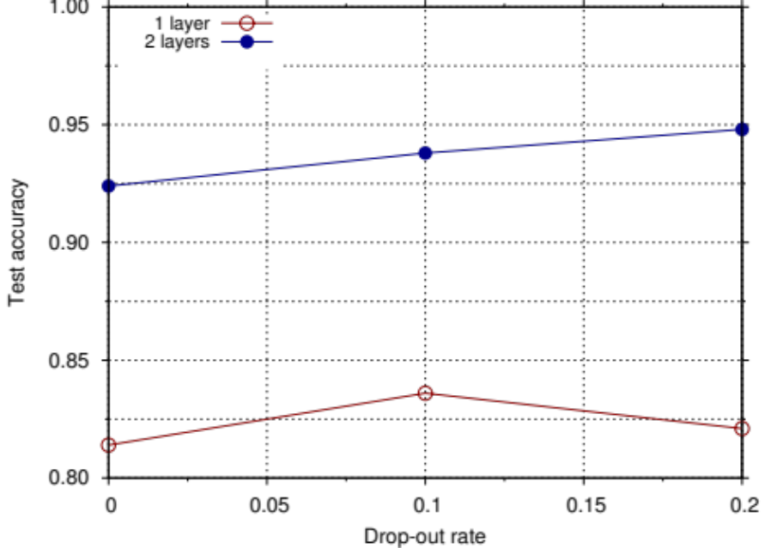
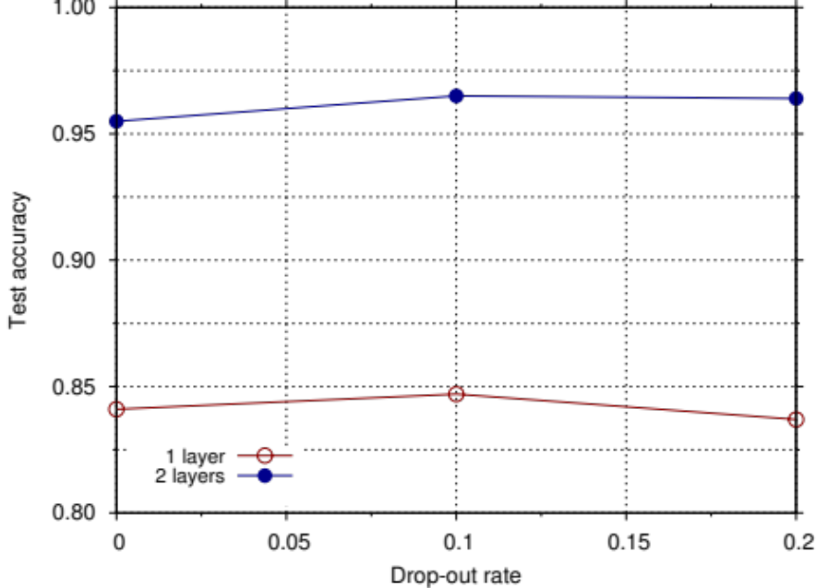
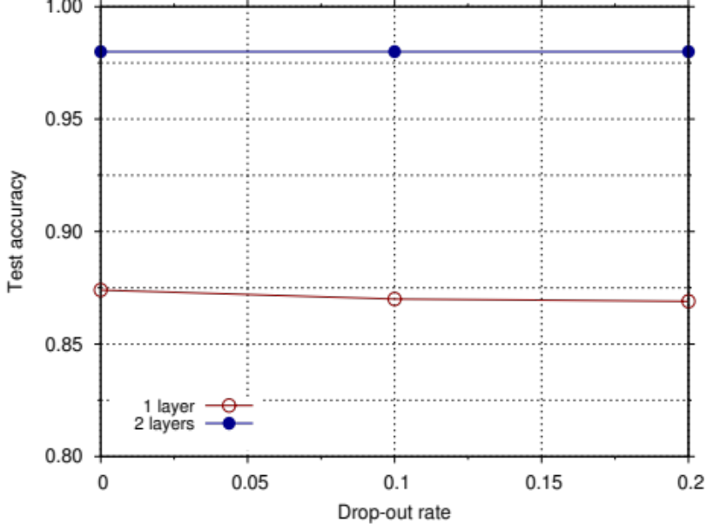
Experimental Results: Entity Detection
Training Data
Base Synthetic Data
(D₀)
Expanded synthetic data
(D₁)
Expanded synthetic data with noise
(D₂)
Test F1
Drop-out rate
Drop-out rate
Drop-out rate
10% drop-out is optimal.
Improved synthetic data → Improved model.
Deeper models are better.
Notes:
Parameters
Drop-out in {0, 0.1, 0.25, 0.5}
Synonymous data in {0, 0.3, 0.6, 1.0}
Noisy data in {0, 0.3, 0.6, 1.0}
1 or 2 LSTM layers
For each setting, we report train / validation / test and end-to-end accuracy.

Slide 24
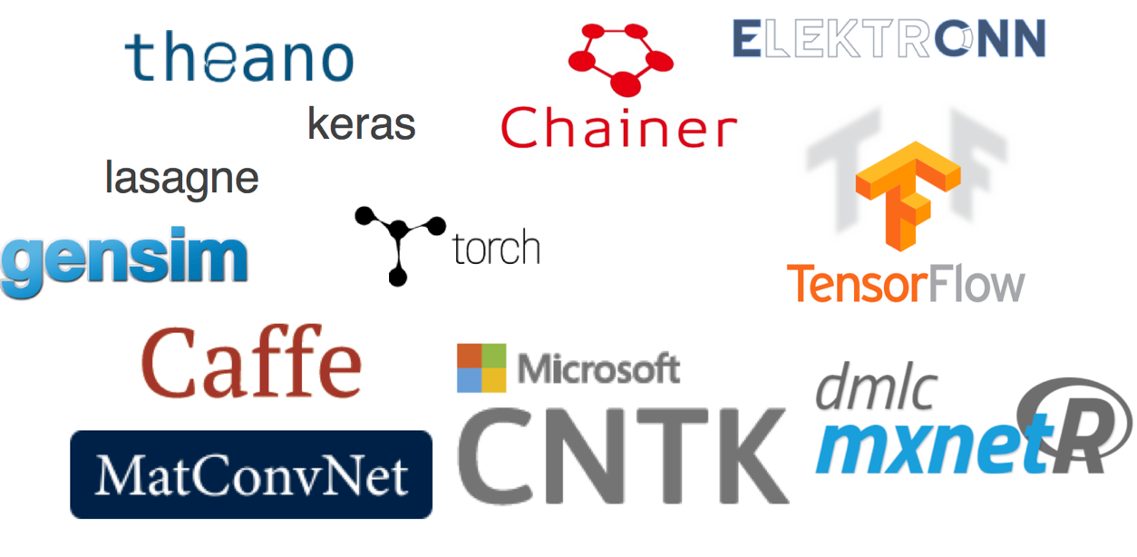
Implementation Details
Notes:
Mention other toolkits similar to keras.
('Number of indexed terms:', 12725984)
Number of nodes in node-to-node index (key=obj): 29467
Number of nodes in node-to-node index (key=subj): 7774333
Number of nodes in node-to-node index (key=attr): 2542057
('Node-to-Node total index size (number of node-node pairs):', 62096492)
Index/Retrieval: In-memory dict objects in python
$$12.8M terms, 10.3M nodes, 62M edges →18GB \text{index}$$

Slide 25
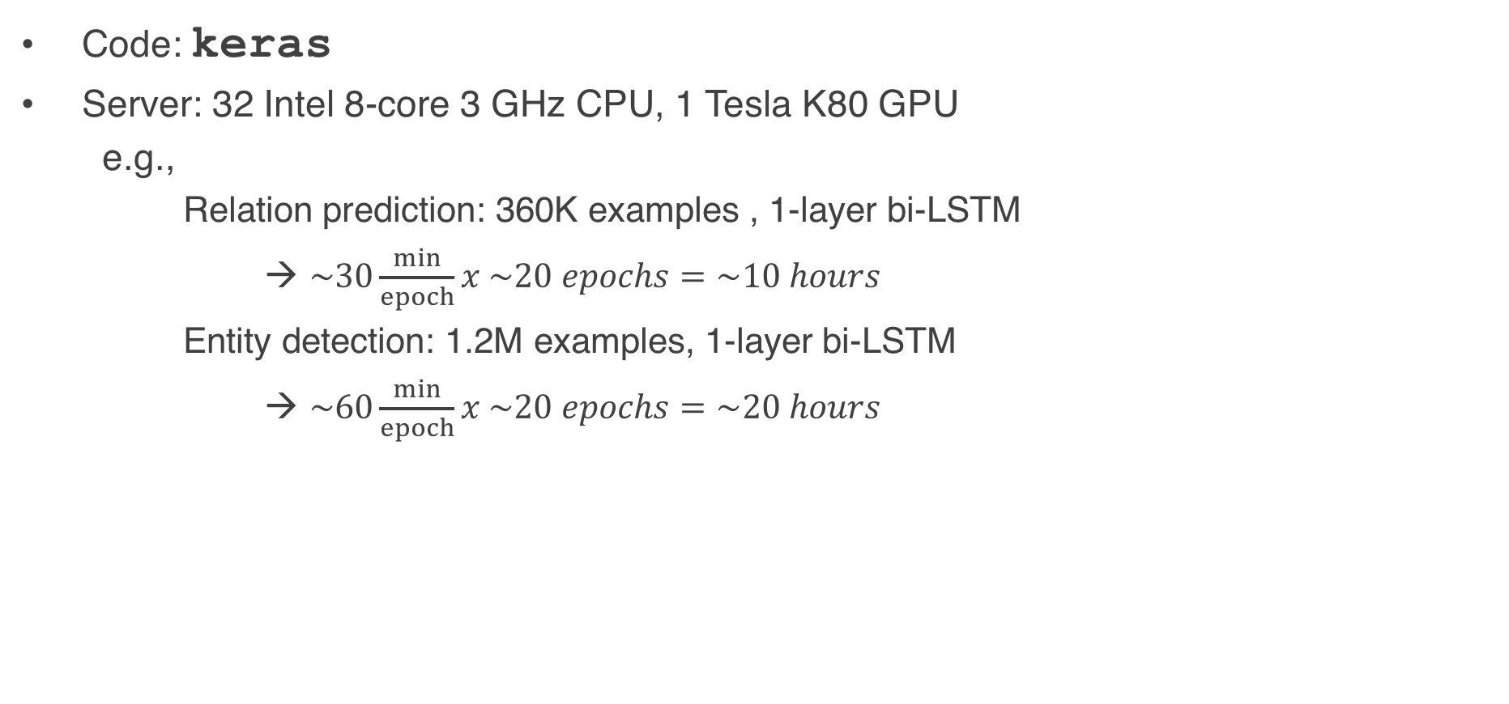
Implementation Details
Code: keras
Server: 32 Intel 8-core 3 GHz CPU, 1 Tesla K80 GPU
  e.g.,
  Relation prediction: 360K examples , 1-layer bi-LSTM
  → $\sim 30\frac{min}{epoch}x \sim 20 epochs=\sim 10 hours$
  Entity detection: 1.2M examples, 1-layer bi-LSTM
  → $\sim 60\frac{min}{epoch}x \sim 20 epochs=\sim 20 hours$
# Embedding layer
model.add(Embedding(vocab_size, embed_size, input_length=15, weights=[vocab_emb], mask_zero=True, trainable=False, dropout=0.1))
# RNN layer
for i in range(0, parameters.use_lstm-1):
model.add(LSTM(embed_size, embed_size, dropout_W=0.1, dropout_U=0.1, go_backwards=True, return_sequences=True))
# Output layer with softmax
model.add(TimeDistributedDense(input_dim=15*embed_size, output_dim=15*num_classes, activation=‘softmax’))
# Compile model
model.compile(loss=‘categorical_crossentropy’, optimizer=‘adam’, metrics=['accuracy'])
# Train model
model.fit(trn[0], trn[1], batch_size=128, nb_epoch=20, validation_split=0.05, callbacks=[checkpointer, history, early_stopping])
Notes:
Mention other toolkits similar to keras.
('Number of indexed terms:', 12725984)
Number of nodes in node-to-node index (key=obj): 29467
Number of nodes in node-to-node index (key=subj): 7774333
Number of nodes in node-to-node index (key=attr): 2542057
('Node-to-Node total index size (number of node-node pairs):', 62096492)
Index/Retrieval: In-memory dict objects in python
$$12.8M terms, 10.3M nodes, 62M edges →18GB \text{index}$$

Slide 26
Performance on Real Queries
35.9 million utterances
(one week of logs)
164 “How old …” questions
131 “When was …” questions
QA runtime per question: 60-92 ms
Notes:
Row1=We do not whether answer is correct
Row2=missing from KG OR not answerable OR SR error
Row3=None answerable / nonsense
I scraped some question-like VREX utterances and ran our approach on it:
Retrieve “How old X”? And clean up based on … Report findings …
It is unclear how to separate these questions from the millions of utterances. Suggest action plan.
e.g., Take sample of N VREX logs. Find % that was answered by Wolfram, % not answered, % answered w/o Wolfram. Run all using our system. Find
Pr(we answer | Wolfram answers)
Pr(we fail to answer | Wolfram answers)
Pr(we answer | Wolfram fails to answer)
Pr(we fail to answer | Wolfram fails to answer)
Pr(we answer | not answered)
Pr(we fail to answer | not answered)

Slide 27
Take-away Messages
Synthetic data can be useful! (if you are careful)
First-order Question Answering is NOT solved.
Recurrent NNs are great for modeling classification / tagging.
Deep Learning can be practical!
Thanks!
Website: dclabs.comcast.com
Email: ferhan_ture@cable.comcast.com
Notes:
Finally, I’d like to emphasize that deep learning can be practical. We see more and more companies deploying deep learning models for various products. In our case, we were able to simplify our model to the extent that it could run in real time, scale up to millions of devices, without giving up the benefits of deep learning. As a result, our customers will be able to ask their TVs about entertainment trivia without leaving their couches. ☺ Thanks!

Slide 28
Backup Slides

Slide 29
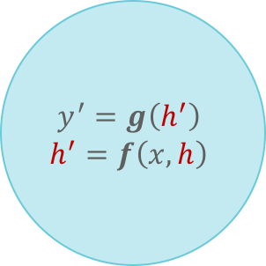
Neural Networks for NLP
0.39
0.61
0.89
0.11
output
memory
hidden
input
washington
heights
word

Slide 30
Deep Learning for Question Answering
Entity Detection / Tagging
Relation Prediction / Classification
place
of death
C
E
E
C
C
C
E
E
C
C
C
E
E
C
C
where
bin
laden
got
killed
where
bin
laden
got
killed

Slide 31
Modeling with RNNs: Overfitting
memory
releaseDate
when
was
matrix
released
Notes:
Drop-out: avoids over-fitting by randomly removing dimensions.

Slide 32
Modeling with RNNs: Overfitting
memory
N/A
when
was
matrix
produced
Notes:
Purpose of well-trained embeddings: similar words appear closer to each other in embedding space. However, this does not help unless RNN shows the right amount of leniency.
Drop-out: avoids over-fitting by randomly removing dimensions.

Slide 33
Modeling with RNNs: Overfitting
memory
N/A
when
has
matrix
released
Notes:
Drop-out: avoids over-fitting by randomly removing dimensions.

Slide 34
Question Answering with Structured Knowledge Base
Structured
Query
Subj=c₁
Obj=?
Attr=c₂
Rel=r
Retrieval
Fact
Knowledge
Graph
e | r | e’
subj | rel | (attr) | obj
Notes:
Issues with using KG for training the model:
Overfitting to the knowledge graph (i.e., trained model performs badly on questions for which answers are in a different KG): this is actually fine since we do not need to generalize to other knowledge graphs.
Overfitting of model to training questions (i.e., trained model performs badly on unseen questions about this KG): we need to be careful about this, and I’ll talk about several remedies.

Slide 35
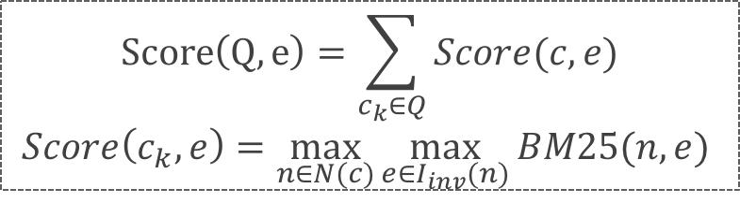




Retrieval
Knowledge
Graph
Index
subj | rel | (attr) | obj
Inverted Index
Reachability Index
Q
$$I_{inv}$$
$$I_{reach}$$
Subj=c₁
Obj=?
Attr=c₂
Rel=r
Find
Source Entity
Nodes
Sort
Answers
List$<e,Score\left(Q,e\right)>$
$$\underset{e′}{\text{arg}max}{\max_{(e−r−e^{′})∈I_{reach}}{Score\left(Q,e\right)}}$$
$$Score\left(Q,e\right)=\sum_{c_{k}∈Q}{Score(c,e)}$$
$$Score\left(c_{k},e\right)=\max_{n∈N(c)}{\max_{e∈I_{inv}(n)}{BM25(n,e)}}$$
Fact
e | r | e’
Notes:
c is a constraint in Q
(e.g., attr=“Donovan”)

Slide 36
Limitations
What is BBT about?
Relation=keyword? theme? genre?
entity
culture
clash
.
.
.
college
life
theme
theme
.
.
.
friends
keyword
BBT
genre
keyword
.
.
.
sitcom
prodigy
Notes:
Problem: 1) If we predict incorrect relation, there’s no way to recover. 2) If we get multiple answers that meet constraints, no way to sort them (potentially using other info like popularity, content matching, time, personalization, etc)
Solution: Two-step answering: A- Find all candidate answers based on entities in question. B- Rank each candidate answer based on rich features (e.g., path, context, content)
Other advantage of this new approach: we can easily expand to higher-order questions using exact same approach.
Even questions like “What was the last GoT episode I watched?” can be answered with this framework, using “usage history” features.

Slide 37
Limitations
What is BBT about?
Relation=keyword? theme? genre?
entity
culture
clash
.
.
.
college
life
theme
theme
.
.
.
friends
keyword
BBT
genre
keyword
.
.
.
sitcom
prodigy
Notes:
Input is a question, from which we predict a relation type, and extract the entities.
Given knowledge graph, we filter out all parts of the graph that do not meet constraints i.e., reachable by all entities and only of predicted relation type.
This currently works great (and extremely fast) for the type of questions we have trained for. Give some examples from test set.

Slide 38
Limitations
What is BBT about?
Relation=keyword? theme? genre?
entity
culture
clash
.
.
.
college
life
theme
theme
.
.
.
friends
keyword
BBT
genre
keyword
.
.
.
sitcom
prodigy
Notes:
Input is a question, from which we predict a relation type, and extract the entities.
Given knowledge graph, we filter out all parts of the graph that do not meet constraints i.e., reachable by all entities and only of predicted relation type.
This currently works great (and extremely fast) for the type of questions we have trained for. Give some examples from test set.

Slide 39
Limitations
Show me the BBT episode where Sheldon gets engaged
entity
entity
actor
…
…
synopsis
Relation=episode?
actor? synopsis?
synopsis
actor
s1e1
Sheldon
Cooper
s9e17
episode
episode
actor
.
.
.
s1e2
episode
BBT
actor
episode
…
synopsis
episode
.
.
.
s7e9
s1e3
synopsis
synopsis
…
…
actor
Notes:
Input is a question, from which we predict a relation type, and extract the entities.
Given knowledge graph, we filter out all parts of the graph that do not meet constraints i.e., reachable by all entities and only of predicted relation type.
This currently works great (and extremely fast) for the type of questions we have trained for. Give some examples from test set.

Slide 40
New Approach
Show me the BBT episode where Sheldon gets engaged
entity
entity
question
actor
…
…
synopsis
answer context
synopsis
Does this answer the question?
actor
s1e1
Sheldon
Cooper
s9e17
episode
episode
actor
.
.
.
s1e2
episode
BBT
actor
episode
0 < score < 1
…
synopsis
episode
.
.
.
s7e9
Context Features:
Are there words in question that also appear in synopsis?
Path from question to answer
Type of answer
Number of entities
s1e3
synopsis
synopsis
…
…
actor
Notes:
Input is a question, from which we predict a relation type, and extract the entities.
Given knowledge graph, we filter out all parts of the graph that do not meet constraints i.e., reachable by all entities and only of predicted relation type.
This currently works great (and extremely fast) for the type of questions we have trained for. Give some examples from test set.

Slide 41
New Approach
Show me the BBT episode where Sheldon gets engaged
entity
entity
question
actor
…
…
synopsis
answer context
synopsis
Does this answer the question?
actor
s1e1
Sheldon
Cooper
s9e17
episode
episode
actor
.
.
.
s1e2
episode
BBT
actor
episode
…
synopsis
episode
0.83
0.05
0.27
0.12
.
.
.
s7e9
0.92
s1e3
synopsis
synopsis
…
…
actor
Notes:
Input is a question, from which we predict a relation type, and extract the entities.
Given knowledge graph, we filter out all parts of the graph that do not meet constraints i.e., reachable by all entities and only of predicted relation type.
This currently works great (and extremely fast) for the type of questions we have trained for. Give some examples from test set.

Slide 42
Performance on Real Queries
Error Analysis | How old … | When was …
Entity + relation with answer | 130 | 90
Entity + relation no answer | 22 | 36
No entity | 9 | 0
Wrong relation | 1 | 4
No entity + wrong relation | 2 | 1
Total | 164 | 131
92%
96%
how old is she
how old am i
how old and kumar
how old is president obama
how old is ross lynch is girlfriend
when was him
when was dove cameron porn
when was seinfeld created
when was the newest episode of steven universe
No clear answer
or nonsense
Notes:
Row1=We do not whether answer is correct
Row2=missing from KG OR not answerable OR SR error
Row3=None answerable / nonsense
I scraped some question-like VREX utterances and ran our approach on it:
Retrieve “How old X”? And clean up based on … Report findings …
It is unclear how to separate these questions from the millions of utterances. Suggest action plan.
e.g., Take sample of N VREX logs. Find % that was answered by Wolfram, % not answered, % answered w/o Wolfram. Run all using our system. Find
Pr(we answer | Wolfram answers)
Pr(we fail to answer | Wolfram answers)
Pr(we answer | Wolfram fails to answer)
Pr(we fail to answer | Wolfram fails to answer)
Pr(we answer | not answered)
Pr(we fail to answer | not answered)

Slide 43
Results on Benchmark
Evaluate our approach against competition on a benchmark dataset.
Understand challenges in first-order question answering.
Datasets | Size | Vocabulary size
WebQuestions | ~6k | 2905
SimpleQuestions | ~100k | ~55k
Knowledge Graph
# Facts | 17.8M
# Relations | 2750
# Entities | 4.0M
e.g.,
Which genre of album is harder.....faster?
how does engelbert zaschka identify
who is the creator of loud
Where is buckingham palace located
What's a battle that took place in the
kingdom of prussia
Name a netflix film that uses hindi language?
what is michael kors real name?
where bin laden got killed?
when was president john adams elected?
what was queen elizabeth ii childhood nickname?
whats the name of the organization that was founded by frei otto
what fruit can be eaten as directed by veganism
Notes:
We already have regression tests to check for specific expected behavior of our approach.

Slide 44
Results on Benchmark
Stanford
NLP
Approach | Web Questions | Simple Questions
Lambda Calculus (Berant et al, 2013) | 31.4 | -
Graph Embedding (Yang et al, 2014) | 41.3 | -
CCG Semantic Parser (Reddy et al, 2014) | 41.0 | -
Memory Network (Bordes et al, 2015) | 42.2 | 63.9
Our approach | 35.1 | 71.0
+ entity retrieval | 38.4 | 79.5
+ relation correction | 52.2 | 88.3
(pick most frequent relation) | 2.6 | 4.1
(assume entire query is entity) | 38.8 | 58.9
Facebook
AI

